Slide 1
Fuzzing and Symbolic Execution

Slide 2
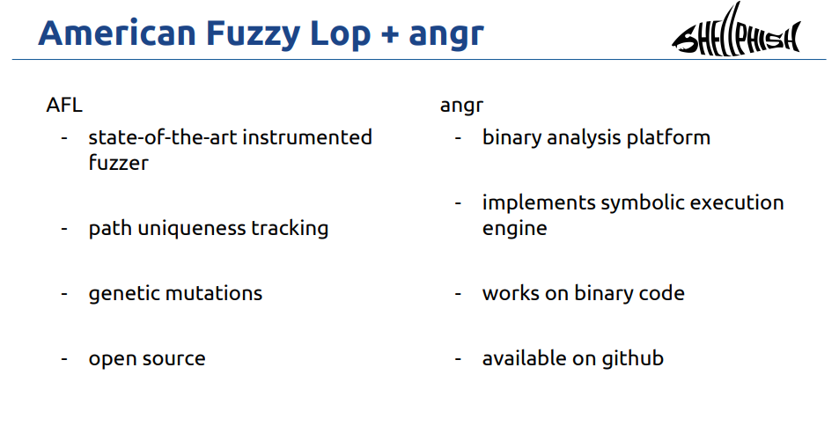
What did entries in DARPA’s Cyber Grand Challenge (CGC) have in common?
Smart fuzzers and symbolic execution
“Million Dollar Baby” talk from Shellphish

Slide 3
Used to automatically exploit crackaddr
Vulnerability found in 2003 by Mark Dowd
Boiled down to 60 lines of C code by Halvar Flake in 2010
Write an e-mail to take complete control of every e-mail server on the planet
Bug in e-mail parsing
Complex state machine with more states than atoms in the universe
Static analysis blows up due to path explosion

Slide 4
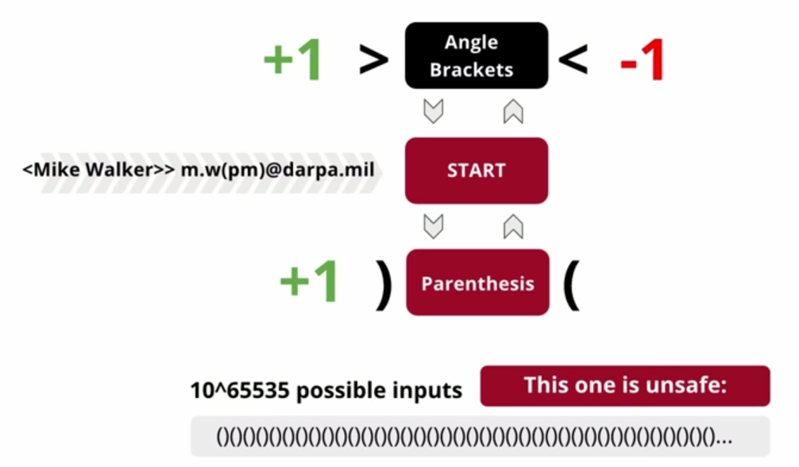
Exploiting crackaddr
Found automatically in CGC by ShellPhish via smart fuzzing and symbolic execution (driller and angr)

Slide 5
Details
DARPA’s CGC video commentary
https://youtu.be/SYYZjTx92KU?t=1h18m57s (3:47 to 1h22m44s)
Changing CTFs
Hours of analysis down to minutes of programming
All open-sourced
https://youtu.be/SYYZjTx92KU?t=1h59m50s (1:31 to 2hr01m21s)
Static, dynamic analysis, fuzzing, formal methods
All of the above?
https://youtu.be/SYYZjTx92KU?t=2h03m48s (0:37 to 2hr04m25s)
Details
http://www.phrack.org/papers/cyber_grand_shellphish.html

Slide 6
Smart fuzzing and symbolic execution
Two of the most important tools in dynamic analysis
Symbolic execution enumerates constraints on inputs that lead to specific program states
Fuzzing zeroes in quickly on input that leads to specific problematic program states
Changing the way we test and analyze code
Finding and exploiting latent vulnerabilities automatically
Testing all code paths through complex programs
Determining binary equivalence of metamorphic malware (e.g. instruction re-ordering, register swapping, instruction substitution, junk code)
Reverse-engineering backdoor triggers

Slide 7
Smart fuzzing and symbolic execution
Going mainstream
AppStore (ioS) now requires apps to compile to LLVM bytecode for analysis!
So they can be analyzed using fuzzers and symbolic execution automatically
oss-fuzz
Google service for nightly fuzzing of critical open-source projects
Microsoft Security Risk Detection
Cloud service for automated fuzzing and symbolic execution of code
Implemented as a service
DevOps processes (CI/CD) changing to integrate tools
Test-driven development (Kent Beck – 2003)
Now, with fuzzing
Every API a fuzzing target
Continuous Integration with continuous fuzzing

Slide 8
Smart fuzzing

Slide 9
Fuzzing
Term coined in 1988 for generating random input to crash a program
Used increasingly to do automated software testing
Can you trust programs like strings, less, file, convert, ldd, nm, objdump, readelf, and unzip on unknown files?
Can you guarantee no memory corruption errors exist in these essential tools?
Example: strings
October 2014 crash reported by Michael Zalewski
Leads to binutils change disallowing executable parsing by default

Slide 10

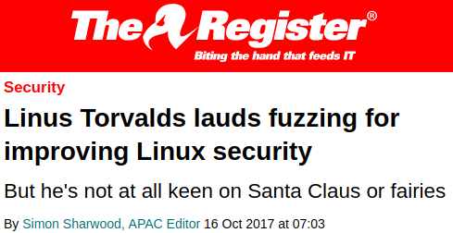
Better than Santa Claus?

Slide 11
Types
Black-box vs. White-box fuzzing
Black box treats software opaquely and brute-forces input patterns (not efficient)
White box instruments software via special compiler and uses algorithms to generate input patterns
Example of the difference in your lab
Coverage-based fuzzing
Search fuzzing input based on how close it gets to hitting new code paths (e.g. higher coverage)
Can use evolutionary algorithms to drive search
Random fuzzing vs. Mutation-based fuzzing
Use random input
Hard to exercise every line of code in program and 10^65535 inputs
Obtain corpus of well-formed input and then mutate to observe results

Slide 12
Types
Grammar fuzzing, template fuzzing (Wadi for Internet Edge)
Randomize within BNF (Backus-Naur form)
Aitel: Block-based Fuzzing
Examples
Within a document or data-exchange format (HTML, XML, JSON)
Within an authorization token (OAuth2, Cookies, JSON Web Token (JWT))
Within an API (REST, gRPC)
Within a protocol (TLS, cipher suites, TCP)

Slide 13
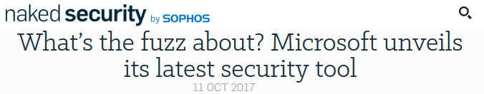
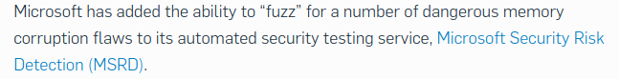
Example: Microsoft's SAGE (2008)
White-box fuzzer used internally at Microsoft to test all Office products and all operating systems (Windows 7 and beyond)
Released recently as Project Springfield (https://www.microsoft.com/en-us/security-risk-detection/)

Slide 14
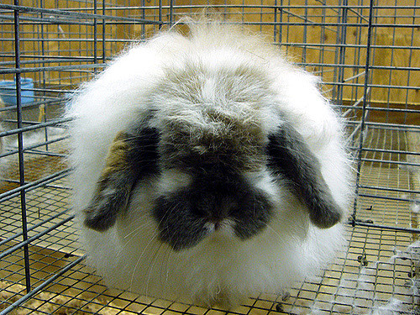
Example: American Fuzzy Lop (AFL) (2013)
Coverage-based, white-box fuzzer using mutation and evolution
Used by most teams and all three winners of DARPA Cyber Grand Challenge
Used to identify bugs in…
libtiff, libjpeg, libpng, openssl, GNU TLS, sqlite
Apple Safari, Internet Explorer, Mozilla Firefox, Adobe Flash, LibreOffice, Putty
nptd, nginx, tcpdump, bash
PHP
Used to find Heartbleed bug in 6 hours (4/2015) via out-of-process fuzzing
You will find it in your lab in under 6 minutes

Slide 15
Example: libfuzzer
Coverage-based fuzzing of functions developed at Google (2015)
Fuzzing done at function-level
Avoids process re-execution to fuzz code
Used to fuzz Chrome since 2015
Used to find Heartbleed bug in 10 seconds (4/2015) via in-process fuzzing
Now Part of LLVM/Clang
Basis for oss-fuzz (2016)
Ffuzzing as a service for open-source projects
Google pays developers of critical open-source projects to submit their code for fuzzing

Slide 16
Example errors
Buffer overflow
Stack overflow
Array out-of-bounds access, off-by-1
Heap overflow
Use-after-free
Double-free
etc..

Slide 17
Examples
#include <stdio.h>
int main()‏
{
long is_admin = 0;
char password[9];
scanf("%s", password);
}
#include <stdio.h>
int main() {
int a[2] = {3,1};
printf("%i\n", a[2]);
}
#include <stdio.h>
#include <stdlib.h>
int main() {
char *c = calloc(10,1);
printf("%i\n", c[0]);
free(c);
printf("%i\n", c[1]);
}
#include <stdio.h>
int main(int argc, char *argv[]) {
if (argc == 2) {
printf("Hello, ");
printf(argv[1]);
}
else
printf("Failure.\n");
}

Slide 18
American Fuzzy Lop (AFL) Lab
Use AFL to find input that reveals vulnerabilities in source code quickly
Can be done locally on linuxlab, but…
Practice with the cloud (Google Compute Engine)
Practice with containers (Building and running your own Docker containers)

Slide 19
AFL lab
Steps
Compile with afl-wrapper to gcc or clang
afl-gcc –o vulnerable vulnerable.c
Fuzz
~/afl/afl-fuzz -i inputs -o out ./vulnerable
Note: can be seeded with initial input (in the directory specified by –i )
Random or valid input

Slide 20
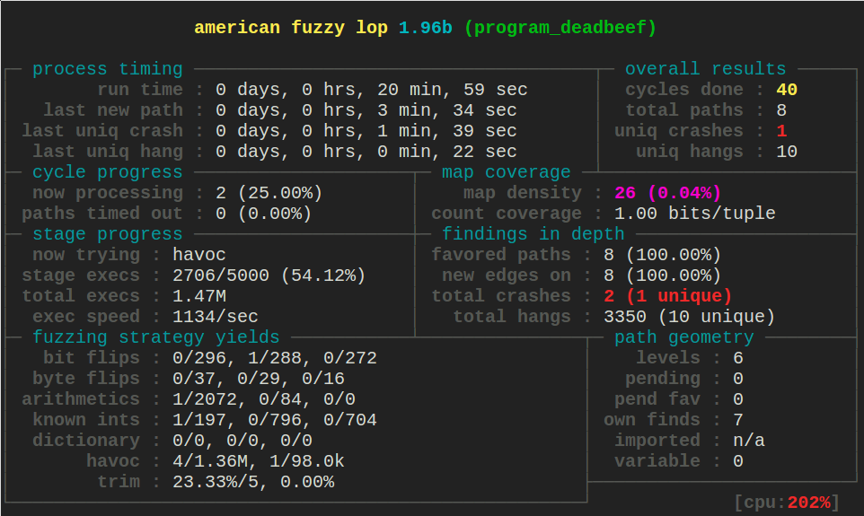
AFL example
int main(int argc, char **argv) {
char ptr[20];
if (ptr[0] == 'd')
if (ptr[1] == 'e')
if (ptr[2] == 'a')
if (ptr[3] == 'd')
if (ptr[4] == 'b')
if (ptr[5] == 'e')
if (ptr[6] == 'e')
if (ptr[7] == 'f')
abort();
else printf("%c",ptr[7]);
else printf("%c",ptr[6]);
else printf("%c",ptr[5]);
else printf("%c",ptr[4]);
else printf("%c",ptr[3]);
else printf("%c",ptr[2]);
else printf("%c",ptr[1]);
else printf("%c",ptr[0]);
return 0;
}

Slide 21
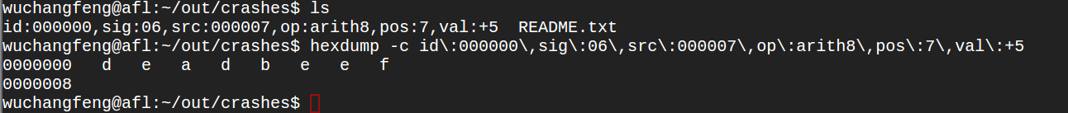
AFL example
Quickly generates output that crashes binary
Code with 128^8 combinations!
Note: can be seeded with initial input to make process faster

Slide 22
Best used with address sanitization (asan)
Compiler option for building binaries to add bounds checks on every memory access
-fsanitize=address
Shadow memory tracking which memory areas are valid
Flag *all* invalid memory accesses
Finds out of bounds access and use after free bugs
afl/asan combination is gold standard of fuzzing

Slide 23
Lab

Slide 24
Symbolic execution
Another step forward to the day when computers do everything humans do but better.
Note: All of the good parts of this presentation and CTF are from Jake Springer
Everything else, I added

Slide 25
But first…
Google Cloud Platform installation
See lab handout to install angr and download CTF binaries

Slide 26
Symbolic execution
Workhorse for modern program analysis and testing
Used internally to test all Microsoft applications (PowerPoint, Word, etc.)
Automatic evaluation of input patterns that cause program to reach a particular state
Potentially test an infinite number of input cases
Beats brute-force fuzzing or test case generation
What is it?
Algebra for your programs
Or to many of us, CTFs for the lazy!

Slide 27
A Simple Capture-the-Flag Level
/* In C */ printf("Enter the password: ");
scanf("%8s",buff);
if (strcmp(buff,pass)) {
printf ("Try again.\n");
} else {
printf("Good Job.\n");
}
# In Python
user_input = raw_input('Enter the password: ')
if user_input == 'hunter2':
print 'Good Job.'
else:
print 'Try again.'
There are many solutions:
Use objdump or readelf to find pass (i.e. the string ‘hunter2’).
Use ltrace to find the comparison.
Use a debugger and inspect the memory where the password is stored.

Slide 28
A Complex Capture-the-Flag Level
# A complex guessing game. Don’t bother to figure out what the code does.
def encrypt(string, amount):
for i in range(0, len(string)):
string[i] += amount
user_input = raw_input('Enter the password: ')
if encrypt(user_input, amount=1) == encrypt('hunter2', amount=2):
print 'Good Job.'
else:
print 'Try again.'
There are many not as many solutions:
Use objdump or readelf to find the string ‘hunter2’. No, ‘hunter2’ isn’t the password anymore.
Use ltrace to find the comparison. No, the strings it compares aren’t what you entered nor the password.
Use a debugger and inspect the memory where the password is stored. Nope. Same as above.
Reverse engineer the encrypt function. Simple in this example, but it could be really complex in a different one.

Slide 29
Solution: Symbolic Execution
What’s that? It’s a system that walks through all* possible paths of a program.
Let’s work through an example.
*some: for many programs, this would be impossible (even if we decided that a path that never halts is considered the “end” of a branch, the halting problem shows that determining when a branch is considered done is undecidable), and for others it would take longer than the universe has existed so far to traverse all paths.

Slide 30
Goal
You are here
1 user_input = raw_input('Enter the password: ')
2 if user_input == 'hunter2':
3 print 'Good Job.'
4 else:
5 print 'Try again.'
You want to find an input that arrives here

Slide 31
Step 1: Inject a Symbol
1 user_input = raw_input('Enter the password: ')
2 if user_input == 'hunter2':
3 print 'Good Job.'
4 else:
5 print 'Try again.'

Slide 32
But first, what is a Symbol?
Remember high school algebra?
x² + 2x + 3 = 4
Think of a symbol as x, except that it’s a variable in the program.
We don’t know what x is. We want to find out. Same with a symbol.
x depends on the equation(s) that constrain it.
A symbol depends on the execution path(s) that constrain it.
…but wait, what is an execution path?

Slide 33
What is an Execution Path?
It’s a possible way to travel through the program.
For example…
1 user_input = raw_input('Enter the password: ')
2 if user_input == 'hunter2':
3 print 'Good Job.'
4 else:
5 print 'Try again.'
…has two possible execution paths.

Slide 34
Step 1: Inject a Symbol
Turn user_input into a symbol and perform execution with symbol
Ask symbolic execution engine to find an execution path that reaches line 3, then solve for symbol.
You just injected a symbol.
You are here
1 user_input = λ
2 if user_input == 'hunter2':
3 print 'Good Job.'
4 else:
5 print 'Try again.'

Slide 35
Step 2: Branch
1 user_input = λ
2 if user_input == 'hunter2':
3 print 'Good Job.'
4 else:
5 print 'Try again.'
You are here
What happens when you reach an if statement that depends on a symbol? You branch.

Slide 36
What does it mean to branch?
Branching just means to split into the different possible execution paths.
Symbols updated with constraints that branch imposes
1 user_input = λ
2 if user_input == 'hunter2':
3 print 'Good Job.'
4 else:
5 print 'Try again.'
You are here
Path 1: λ equals 'hunter2'
Path 2: λ does not equal 'hunter2'
user_input = raw_input('Enter the password: ')
if user_input == 'hunter2’ # it is equal!
print 'Good Job.’
user_input = raw_input('Enter the password: ')
if user_input == 'hunter2’ # it’s not equal.
print ’Try again.’

Slide 37
Step 3: Evaluate each branch with symbols
Let’s imagine we picked the ‘λ does not equal “hunter2”’ branch first.
1 user_input = λ
2 if user_input == 'hunter2':
3 print 'Good Job.'
4 else:
5 print 'Try again.'
You are here
We are at the end of the execution and didn’t find what we wanted. Continue with the other branch!

Slide 38
Step 3: Evaluate each branch with symbols
Now we chose the ’λ equals “hunter2”’ branch.
1 user_input = λ
2 if user_input == 'hunter2':
3 print 'Good Job.'
4 else:
5 print 'Try again.'
You are here
We found what we wanted! We now have an execution path that can constrain the symbol. We can solve for λ to find the password (trivial in this case since only one constraint and one possible solution)

Slide 39
A More Complex Example
The following is source code from Ch06CAsm_Conditionals
#define SECRET 100
int check_code(int input) {
if (input >= SECRET+88) return 0;
if (input > SECRET+100) return 0;
if (input == SECRET+68) return 0;
if (input < SECRET) return 0;
if (input <= SECRET+78) return 0;
if (input & 0x1) return 0;
if (input & 0x2) return 0;
if (input & 0x4) return 0;
return 1;
}
What are the possible paths?

Slide 40
if (input >= SECRET+88)
return 0;
if (input > SECRET+100)
return 0;
if (input == SECRET+68)
Paths can be represented as a tree.
return 0;
if (input < SECRET)
return 0;
if (input <= SECRET+78)
#define SECRET 100
int check_code(int input) {
if (input >= SECRET+88) return 0;
if (input > SECRET+100) return 0;
if (input == SECRET+68) return 0;
if (input < SECRET) return 0;
if (input <= SECRET+78) return 0;
if (input & 0x1) return 0;
if (input & 0x2) return 0;
if (input & 0x4) return 0;
return 1;
}
return 0;
if (input & 0x1)
return 0;
if (input & 0x2)
return 0;
if (input & 0x4)
return 0;
return 1;

Slide 41
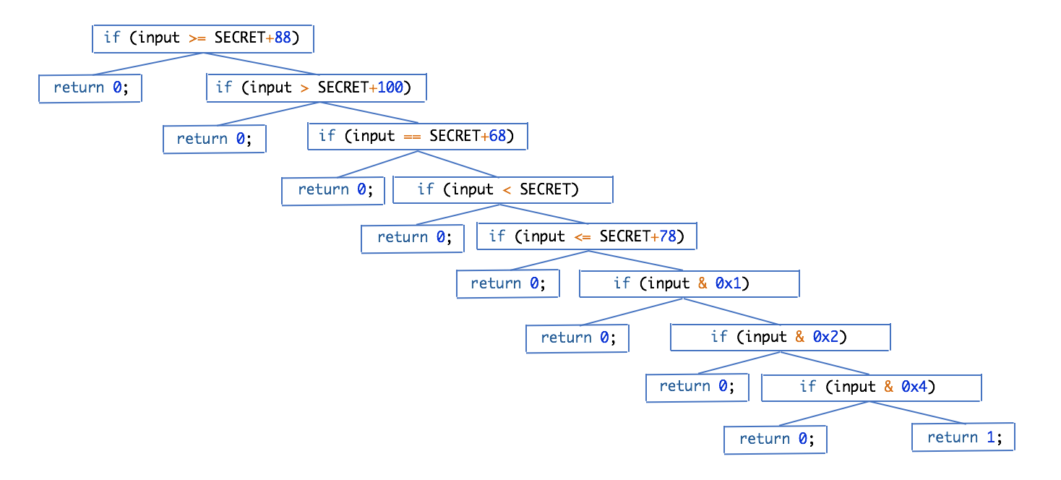
Solving a More Complex Example: Part 1
Perform symbolic execution
We can perform any tree search algorithm to find the node that returns 1.
Breadth-first search
Why not use depth-first search?

Slide 42
Solving a More Complex Example: Part 2
if (input >= SECRET+88)
Once we have a path, we can build an equation that can be solved with a satisfiability modulo theories (SMT) solver:
if (input > SECRET+100)
if (input == SECRET+68)
if (input < SECRET)
input >= SECRET+88
∧ input > SECRET+100
∧ input == SECRET+68
∧ input < SECRET
∧ input <= SECRET+78
∧ input & 0x1
∧ input & 0x2
∧ input & 0x4
if (input <= SECRET+78)
if (input & 0x1)
if (input & 0x2)
if (input & 0x4)
return 1;
Remember, SECRET = 100.

Slide 43
The Real World™
Of course, in the real world, the binaries will be complex. There could be many symbols and many branches. The exponential growth of the complexity of the binary is symbolic execution’s largest problem.

Slide 44
Combining coverage-based fuzzing with symbolic execution
Dynamically generate new tests using a combination of both approaches
Manage state explosion by concretizing some parts of input known to be uninteresting (i.e. does not lead to novel paths)
From crashes, figure out which constraints needed to reach the crash via symbolic execution
Fuzz those constraints preferentially
Drills into program more effectively
Codepath has if (input == 0xbadf00d) ?
Concretize based on constraints and then symbolically execute from there
If fuzzer gets stuck, pass to symbolic execution engine to help with finding new paths
If symbolic execution engine blows up, pass to fuzzer to concretize

Slide 45
Symbolic execution with angr
UCSB built a powerful tool called angr to perform symbolic execution, then open-sourced it.
It’s written in Python and it operates on native binaries (no source code required!).
https://github.com/angr
We decided to develop a CTF to help you learn how to use angr…

Slide 46
Symbolic Execution CTF: Part 1

Slide 47
What is Angr?
Angr is a symbolic execution engine*.
It can:
Step through binaries (and follow any branch)
Search for a program state that meets a given criteria
Solve for symbolic variables given path (and other) constraints
*and more, but use of the included binary analysis tools unrelated to symbolic execution is out of the scope of these slides and the associated CTF.

Slide 48
Recall, the foundation of symbolic execution involves two principles:
Execution Paths
Symbols
We will begin by discussing execution paths.

Slide 49
An Execution Path in Angr
if (input >= SECRET+88)
An execution path represents a possible execution of the program that begins somewhere and ends somewhere else.
if (input > SECRET+100)
if (input == SECRET+68)
if (input < SECRET)
if (input <= SECRET+78)
A node of an execution path in Angr is represented by a ‘SimState’ object. As the name suggests, it stores the state of the program, as well as a history of the previous states.
if (input & 0x1)
if (input & 0x2)
if (input & 0x4)
return 1;

Slide 50
A Set of Execution Paths
With symbolic execution, we care about all* (as many as possible) execution paths, so that we can search them to find the one we want.
We’ll talk about searching later, but first, how do we represent a set of execution paths in Angr, and how do we build them?

Slide 51
Simulation Manager (simgr) in Angr
Angr stores and handles a set of possible paths for a given program in a ‘simulation manager’ object.
Simulation managers provide functionality to step through the program to generate possible paths/states.

Slide 52
Building a Set of Paths
Angr starts the program wherever you instruct it to start (this is the first active state)
Execute instructions in each active (nonterminated) state until we reach a branching point or the state terminates
At every branching point, split the state into multiple states, and add them to the set of active states
Repeat steps 2..4 until we find what we want or all states terminate

Slide 53
Animation: Building a Set of Paths
Legend:
Blue = already executed
Green = active
Red = terminated
if (input >= SECRET+88)

Slide 54
Animation: Building a Set of Paths
Legend:
Blue = already executed
Green = active
Red = terminated
if (input >= SECRET+88)
return 0;
if (input > SECRET+100)

Slide 55
Animation: Building a Set of Paths
Legend:
Blue = already executed
Green = active
Red = terminated
if (input >= SECRET+88)
return 0;
if (input > SECRET+100)
return 0;
if (input == SECRET+68)

Slide 56
Animation: Building a Set of Paths
Legend:
Blue = already executed
Green = active
Red = terminated
if (input >= SECRET+88)
return 0;
if (input > SECRET+100)
return 0;
if (input == SECRET+68)
return 0;
if (input < SECRET)

Slide 57
Animation: Building a Set of Paths
Legend:
Blue = already executed
Green = active
Red = terminated
if (input >= SECRET+88)
return 0;
if (input > SECRET+100)
return 0;
if (input == SECRET+68)
return 0;
if (input < SECRET)
return 0;
if (input <= SECRET+78)

Slide 58
Animation: Building a Set of Paths
Legend:
Blue = already executed
Green = active
Red = terminated
if (input >= SECRET+88)
return 0;
if (input > SECRET+100)
return 0;
if (input == SECRET+68)
return 0;
if (input < SECRET)
return 0;
if (input <= SECRET+78)
… etc

Slide 59
Animation: Building a Set of Paths
Legend:
Blue = already executed
Green = active
Red = terminated
if (input >= SECRET+88)
return 0;
if (input > SECRET+100)
return 0;
if (input == SECRET+68)
return 0;
if (input < SECRET)
if (input <= SECRET+78)
We found what we wanted!
return 0;
return 0;
if (input & 0x1)
return 0;
if (input & 0x2)
return 0;
if (input & 0x4)
return 0;
return 1;

Slide 60
Searching for What We Want
Method 1: Search for an instruction address | Method 2: Search for anything else!
Perhaps we want to find this address.
Perhaps we want to find when the variable ‘success’ is equal to true.
804867a: sub $0xc,%esp
804867d: push $0x8048760
8048682: call 8048400 <backdoor@plt>
8048687: add $0x10,%esp
Both of these approaches are trivial! At each step, just check if any active state meets your constraints. Any arbitrary function that determines if we have reached a state we want would work.

Slide 61
State Explosion
The biggest problem with symbolic execution:
With each if statement, the number of possible branches might double. The growth of the problem is exponential with respect to the size of the program.
There is no known good solution to this problem.
A tree representing the paths of a possible program
Image source: http://www.icodeguru.com/vc/10book/books/book3/chap6.htm

Slide 62
One Good Approach: Avoiding States
If you can identify conditions that would indicate that it is unlikely that continuing would lead to a successful state, you can terminate the path immediately and cross off large sections of the state graph. Idea similar to what smart fuzzing does.
We only have to search half of the graph! Saves a lot of time.
Right here a variable is set that tells us that we will not find anything useful down this path.
The successful state is here.
Image source: http://www.icodeguru.com/vc/10book/books/book3/chap6.htm

Slide 63
Avoiding Paths
We can avoid states in the exact same way that we accept them as successful.

Slide 64
How do we determine which conditions might lead to a failed state?
Human intuition!
Also, there are various heuristic algorithms that are mostly out of the scope of these notes. We will briefly touch on a method called Veritesting much later (this is where a lot of academic research is working on)
If you find a better way, publish it!

Slide 65
Summary: Algorithm for Find and Avoid
Load the binary
Specify a starting point and create a simulation manager
While we have not found what we want…
Step all active states
Run our ‘should_accept_state’ predicate on each active state
If one matches, we found what we wanted! Exit the loop
Run our ‘should_avoid_state’ predicate on each active state
For each state that is matches, mark it for termination
Remove all states that are marked for termination from the set of active states

Slide 66
Shortcut: The ‘Explore’ Method
The previous algorithm is so common that Angr wrote a single function to do it for you, called the ‘explore’ function:
simulation.explore(find=should_accept_path, avoid=should_avoid_path)
… will add any path that is accepted to the list ‘simulation.found’
Additionally, searching or avoiding a specific instruction address is common enough that the find and avoid parameters also accept addresses:
simulation.explore(find=0x80430a, avoid=0x9aa442)
… would search for address 0x80430a and terminate anything that reaches 0x9aa442.

Slide 67
Angr-y CTF levels

Slide 68
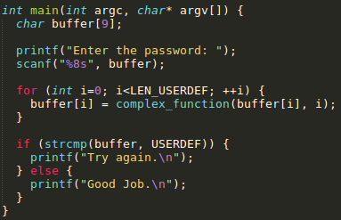
00_angr_find
Our “Hello World” of angr

Slide 69
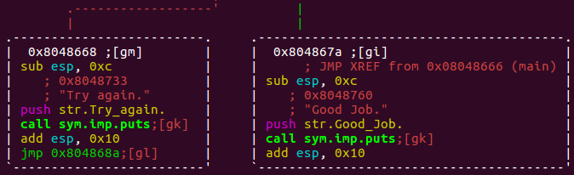
00_angr_find
Analyze binary to find where it prints what you want (0x804867a)

Slide 70
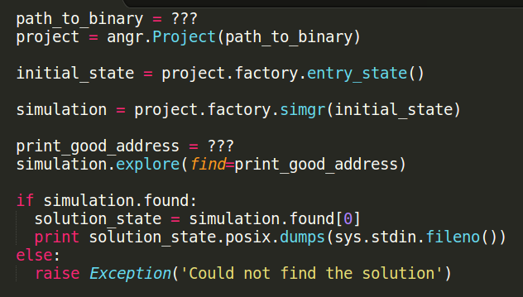
00_angr_find
Each level includes a template solution script (scaffoldXX.py)
Full description of level in comments within each script
Scaffolded so students focus only on one new part of angr per level
scaffold00.py
Specify path to binary (string)
Create project with binary
Start at main()
Location to find input for (integer) Best specified in hexadecimal
Do entire exploration
See if something was found
Get first solution (usually 1 for our CTF)
Concretize input that led to solution

Slide 71
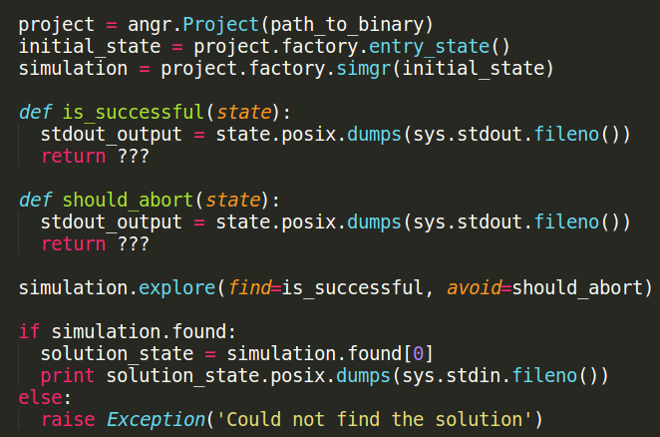
02_angr_find_condition
Can also use alternate conditions to find states
Define a function that represents the
state you want to look for.
Dumps stdout to variable.
Expression that should return true if “Good Job” is in it.
Same as is_successful, but specify states that should abort immediately. States not matching will return false and continue execution.
Return if a state is_successful(). Abort states that should_abort().

Slide 72
Lab
Feel free to work with others, but you must run on your own to solve your own levels
00_angr_find
01_angr_avoid
02_angr_find_condition

Slide 73
Symbolic Execution CTF: Part 2
Introducing Symbols and Constraints

Slide 74
Why are the first three levels of the CTF solved without injecting symbols?
Angr injects them for you!
In some cases, Angr automatically injects a symbols when user input is queried from stdin. *
Can also handle simple calls of ‘scanf’ (without complex format strings.)
You will need to inject symbols manually if the input is more complex, for example:
Arbitrary format string for scanf
From a file
From the network
From interactions with a UI
* It does this with what are called SimProcedures, which we will cover later.

Slide 75
Representation of Symbols: Bitvectors
Angr’s symbols are represented by what it calls bitvectors.
Bitvectors have a size, the number of bits they represent.
As with all data in programming, bitvectors can represent any type that can fit. Most commonly, they represent either n-bit integers or strings.
The difference between a bitvector and a typical variable is that, while typical variables store a single value, bitvectors store every value that meets the execution path’s constraints.

Slide 76
Bitvector Example
Bitvector λ be 8 bits and is constrained by:
( λ > 0, λ ≤ 4, λ mod 2 = 0 ) ∨ ( λ = 1 )
The above is how the bitvector would be stored.
However, if we were to concretize the bitvector (collapse it to a specific value), it could take on any of the following values: 2, 4, or 1.
Concretizing bitvectors via a heuristic is how smart fuzzing techniques can be used in conjunction with symbolic execution

Slide 77
Bitvector types
A concrete bitvector: a bitvector that can take on exactly 1 value.
(Example: { λ: λ = 1 })
A symbolic bitvector: a bitvector that can take on more than 1 value.
(Example: { λ: λ > 10 })
An unsatisfiable bitvector: a bitvector that cannot take on any values.
(Example: { λ: λ = 10, λ ≠ 10 })
An unconstrained bitvector: a bitvector that can take on any value, within the
bounds of its size.

Slide 78
Solving Constraints on Bitvectors
Angr provides a nice frontend to z3, an open-source constraint solver from Microsoft used with Sage. It has the following functionality (and more):
Find any (single) value of a bitvector
Find up to n possible values of a bitvector
Find the maximum or minimum possible values of a bitvector
Determine if a bitvector is satisfiable

Slide 79
Symbols in the Context of a Program State
1 user_input = λ
2 if user_input == 'hunter2':
3 print 'Good Job.'
4 else:
5 print 'Try again.'
We can inject symbols into variables as long as the size of the bitvector is equal to the size of the variable.
Constraints are automatically generated (ex: λ = ‘hunter2’, or, for the other path, λ ≠ ‘hunter2’) as the engine follows a given path.
If we desire, we can manually add constraints to any bitvector at any time during the execution of the program (more later).

Slide 80
Symbol Propagation
user_input
Symbols propagate when values are transferred.
To the right you see the memory, with the variables user_input and encrypted_inputX marked.
All are symbolic, represented by the green.
The variables encrypted_inputX depend entirely on user_input, denoted by the arrow.
user_input = λ
encrypted_input0 = user_input - 3
encrypted_input1 = encrypted_input0 + 15
encrypted_input2 = encrypted_input1 * 7
encrypted_input0
encrypted_input1
encrypted_input2

Slide 81
Constraint Propagation
user_input = λ
encrypted_input0 = user_input - 3
encrypted_input1 = encrypted_input0 + 15
encrypted_input2 = encrypted_input1 * 7
In this example, if we add the constraint: λ = 10, then:
user_input = λ = 10
encrypted_input0 = user_input - 3 = 10 – 3 = 7
encrypted_input1 = encrypted_input0 + 15 = 7 + 15 = 22
encrypted_input2 = encrypted_input1 * 7 = 22 * 7 = 154
We solved for encrypted_input2!
Constraints propagate through the program.

Slide 82
Constraint Reverse-Propagation
We can also add constraints to propagated symbolic values and solve backwards
user_input = λ
encrypted_input0 = user_input - 3
encrypted_input1 = encrypted_input0 + 15
encrypted_input2 = encrypted_input1 * 7
In this example, if we add the constraint: encrypted_input2 = 14, then:
We solved for λ!
λ = user_input, λ = -10
user_input - 3 = encrypted_input0 = -13, user_input = -10
encrypted_input0 + 15 = encrypted_input1 = 2, encrypted_input0 = -13
encrypted_input1 * 7 = encrypted_input2 = 14, encrypted_input1 = 2
Start here, work backwards
Constraints propagating backwards through the program allow us to solve for initial conditions (sound like something you might be interested in?)

Slide 83
The NP-Completeness of Constraint Satisfaction and the Inevitable Heat Death of the Universe
The second huge problem of symbolic execution is that it relies on solving complex systems of constraints.
The constraint-satisfaction problem is NP-complete.
The theory term for no bueno!

Slide 84
Injecting symbols and applying constraints in angr
Some examples of common patterns….

Slide 85
Injecting Symbols Example: Registers
eax
Program (black box)
User input
edx
Output
esi
For simple cases, Angr replaces this for us, so that the user input function injects symbolic values into the registers.
For more complex cases, we need to inject the symbols ourselves. We start the program after the user input and initialize the registers with symbolic values

Slide 86
Injecting Symbols Example: Registers
Start program here
eax
Program (black box)
User input
edx
Output
esi
Because the input is symbolic, the output will be symbolic; we can solve for the input given the output we want (just like always)
Initialize registers with symbolic values

Slide 87
Injecting Symbols Example: Registers
The get_user_input function returns values by writing them to registers.
Solution: Instead of calling get_user_input, write symbolic values to the registers.
Start immediately after the call, here.
call 80487a5 <get_user_input>
mov %eax,-0xc(%ebp)
mov %ebx,-0x8(%ebp)
mov %ecx,-0x4(%ebp)
Evidence that the get_user_input function returned the user input on the registers.
In Angr, you can write to a register with either a concrete or a symbolic value:
state.regs.eax = my_bitvector
will write the symbolic value my_bitvector to eax.

Slide 88
Injecting Symbols Example: Global Memory
User input writes to fixed points in memory
Program (black box)
User input
Output

Slide 89
Injecting Symbols Example: Global Memory
The same principle can be applied to global memory!
Program (black box)
User input
Output

Slide 90
Injecting Symbols Example: Global Memory
get_user_input function returns values by writing them to addresses determined at compile time.
Solution: Instead of calling get_user_input, write symbolic values to the addresses.
scanf(“%u %u”, &a, &b)
Parameters (scanf will write user input to these addresses)
push $0xaf84128
push $0xaf84120
push $0x8048733
call 8048400 <scanf@plt>
Format string “%u %u”
In Angr, you can write to an address with either a concrete or a symbolic value:
state.memory.store(0xaf84120, my_bitvector)
will write the value my_bitvector to 0xaf84120.

Slide 91
Injecting Symbols Example: The Stack
… and, of course, the stack!
ebp
Program (black box)
User input
Output
esp

Slide 92
Injecting Symbols Example: The Stack
What about the stack?
Allocate memory for local variables
sub $0x20,%esp
lea -0x8(%ebp),%eax
push %eax
push $0x80489c3
call 8048370 <scanf@plt>
Specify a specific local variable as a parameter to scanf
Format string
In Angr, you can push to the stack with either a concrete or a symbolic value:
state.stack_push(my_bitvector)
will push the value of my_bitvector to the top of the stack.
You may need to account for anything you don’t care about at the beginning of the stack by adding padding:
state.regs.esp -= 4
adds 4 bytes of padding.

Slide 93
Injecting Symbols Example: Dynamic Memory
Memory allocated on the heap (potentially different every execution; unknown at the start)
…
Program (black box)
?
Output
User input
A pointer pointing to somewhere unknown.

Slide 94
Injecting Symbols Example: Dynamic Memory
Memory we decided to use as symbolic memory
A dummy address we chose that nothing else uses.
0x4444444
Program (black box)
Output
User input
We can overwrite this pointer to point to any address we want.

Slide 95
Injecting Symbols Example: Dynamic Memory
What if you don’t know the memory location scanf to which scanf writes?
Scanf will write to the address stored in the pointer located at 0xaf84dd8
mov 0xaf84dd8,%edx
push %edx
push $0x8048843
call 8048460 <scanf@plt>
If you cannot determine the address to which scanf writes because it is stored in a pointer, you can overwrite the value of the pointer to point to an unused location of your choice (in this example, 0x4444444):
state.memory.store(0xaf84dd8, 0x4444444)
state.memory.store(0x4444444, my_bitvector)
At this point, the pointer at 0xaf84dd8 will point to 0x4444444, which will store your bitvector.

Slide 96
Injecting Symbols Example: The Filesystem
What if our user input function queries from the filesystem (or any other Linux file, including the network, the output of another program, /dev/urandom, etc)?
The filesystem (or other file)
Program (black box)
User input
Output

Slide 97
Representing a File as Memory
Beginning of the stack
Program memory
We can use the same Python type as
state.memory (which is SimMemory) to store other types of data, such as the contents of files!
…
A program has access to an address space, which it uses to store instructions, the stack, the heap, and static data.
We have used it in Angr using the following functions:
state.memory.store(…)
state.memory.load(…)
0x7ffffff
File memory
0x0
Beginning of a file
…
…

Slide 98
Injecting Symbols Example: The Filesystem
File memory (/tmp/hello.txt)
0x0
Note: our file memory is separate from our program memory. Address 0x0 in our file does not correspond to address 0x0 in our program.
We can make the file memory entirely symbolic.
We also have to give it a filename.
…
Program (black box)
User input
Output

Slide 99
Injecting Symbols Example: The Filesystem
In short: Angr allows you to specify an alternate, symbolic filesystem of your own specification. More information on this is included in the CTF.

Slide 100
Angr-y CTF levels

Slide 101
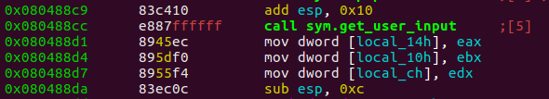
03_angr_symbolic_registers
Three numbers used as password via a formatted scanf within get_user_input()
Difficult to run scanf through symbolic execution
Numbers returned from get_user_input in 3 registers, then used
Have symbolic registers set values after call to get_user_input
Run from address just after function returns
Note Microsoft ASM mov D, S

Slide 102
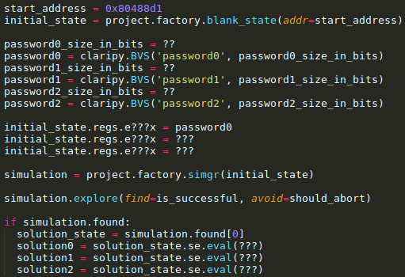
03_angr_symbolic_registers
Claripy
Representing and manipulating symbolic values
Start at address when symbolic values are needed. (After scanf, but before they are moved)
Set symbolic execution start address.
Tell claripy how large the symbolic values are in bits. Declare each of the three integers in password.
Attach symbolic values to specific registers scanf set
Return if a state is_successful(). Terminate states that should_abort().
Evaluate symbolic value to get concrete
integer values that satisfy constraints.

Slide 103
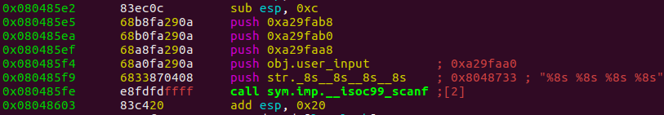
05_angr_symbolic_memory
4 strings used as password via a formatted scanf
Each read into a distinct buffer in memory
Can you identify their individual locations?
Use symbolic memory to set them after input

Slide 104
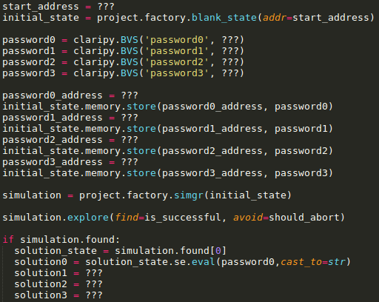
05_angr_symbolic_memory
Start at address when symbolic values are needed after scanf
Tell claripy how large the symbolic values are in bits. How big is each part of the password based on the parameters of the scanf.
Attach symbolic values to specific memory locations scanf set
Check if solution found. If so, solve the
constraints to find an input that satisfies
them. Note eval() returns an integer by default.
To concretize into a string, use the cast_to
named parameter

Slide 105
Lab
Feel free to work with others, but you must run on your own to solve your own levels
03_angr_symbolic_registers
05_angr_symbolic_memory
06_angr_symbolic_dynamic_memory

Slide 106
Symbolic Execution CTF: Part 3
Handling Non-trivial Behavior

Slide 107
Motivation: A Simple Example
Booby trapping symbolic execution
The program iterates through 16 elements, each time it branches.
By the end of the loop, there will be a total of 2¹⁶ or 65,536 branches.
Could be reduced to:
user_input == 'ZZZZZZZZZZZZZZZZ’.
One branch. (Note: This is the opposite problem from the AFL lab!)
def check_all_Z(user_input):
num_Z = 0
for i in range(0, 16):
if user_input[i] == 'Z':
num_Z += 1
else:
pass
return num_Z == 16

Slide 108
Solution
There are algorithms to deduce the insight on the previous slide.
None work as well as human intuition for many cases (yet!).
For complex functions that can be easily simplified by a human, we can use Angr to replace the code with its summary, written in Python.
Two approaches: constraints and hooks

Slide 109
Constraints
Add constraints at specific execution locations
Add a constraint at 0x804877c to ensure the string at 0x804a420
is ‘ZZZZZZZZZZZZZZZZ’
If constraint satisfiable, add state to solution and end search.
...
8048774: add %edx,%eax
8048776: sub $0x4,%esp
804877c: push $0x804a420
8048781: call 8048460 <check_all_Z>
8048786: add $0x10,%esp
8048789: test %eax,%eax
804878b: jne 8048794 <main+0x19f>
...
If string at 0x804a420 is
'ZZZZZZZZZZZZZZZZ’, then ‘Good Job.’ is printed

Slide 110
Hooks
Skip problematic code and implement an alternative
Via function hooks
Via SimProcedures (syntactic sugar for function hooks)

Slide 111
Hooks
...
8048774: add %edx,%eax
8048776: sub $0x4,%esp
804877c: push $0x804a420
8048781: call 8048460 <check_all_Z>
8048786: add $0x10,%esp
8048789: test %eax,%eax
804878b: jne 8048794 <main+0x19f>
...
We want to skip this and instead run our own code.
You can do this using a hook. You specify an address to ‘hook’, the number of bytes of instructions you want to skip, and a Python function that will be run to replace the skipped instructions.
Note: the number of instructions you skip can be zero.

Slide 112
Hook Walkthrough
The parameter to check_all_Z
...
8048774: add %edx,%eax
8048776: sub $0x4,%esp
804877c: push $0x804a420
8048781: call 8048460 <check_all_Z>
8048786: add $0x10,%esp
8048789: test %eax,%eax
804878b: jne 8048794 <main+0x19f>
...
Call to check_all_Z
Let’s imagine we want to replace the call to check_all_Z, with our own check function:
def replacement_check_all_Z():
eax = (*0x804a420 == 'ZZZZZZZZZZZZZZZZ’)
The parameter to check_all_Z
Return values are stored in eax

Slide 113
Hook Walkthrough
...
8048774: add %edx,%eax
8048776: sub $0x4,%esp
804877c: push $0x804a420
8048781: call 8048460 <check_all_Z>
8048786: add $0x10,%esp
8048789: test %eax,%eax
804878b: jne 8048794 <main+0x19f>
...
def replacement_check_all_Z():
eax = (*0x804a420 == 'ZZZZZZZZZZZZZZZZ’)
Call: binary.hook(0x8048776, length=5, replacement_check_all_Z)
The instructions are represented with 16 bytes in memory. If we didn’t want to skip any instructions (and run our Python code in addition to the instructions), we could let length=0.
Function to replace run when we reach our hook
Address we want to hook
(Syntax altered for rhetorical purposes, see CTF for actual syntax)

Slide 114
Hook Walkthrough
Call: binary.hook(0x8048776, length=5, replacement_check_all_Z)
…
8048774: add %edx,%eax
8048776: sub $0x4,%esp
804877c: push $0x804a420
8048781: call 8048460 <check_all_Z>
8048786: add $0x10,%esp
8048789: test %eax,%eax
804878b: jne 8048794 <main+0x19f>
5 bytes
eax = (*0x804a420 == 'ZZZZZZZZZZZZZZZZ’)
…
(Syntax altered for rhetorical purposes, see CTF for actual syntax)

Slide 115
Common Patterns
Hooks are useful for:
Injecting symbolic values partway through the execution.
Replacing complex functions.
Replacing unsupported instructions (for example, most syscalls).

Slide 116
Complex Functions
Replacing complex functions with hooks is so common that Angr included syntactic sugar to make it easier called a SimProcedure
A SimProcedure provides a simple way to replace a function with a summary in a Pythonic way.

Slide 117
Review of Functions
1. Push parameters to the stack
2. Push return address to the stack
3. Jump to function address
4. Handle parameters*
5. Execute function
6. Write return value to appropriate location
7. Pop return address and jump to it
8. Pop parameters
* The standard calling convention for programs compiled with gcc targeting IA-32 does not need to do anything with parameters once the function is called, since they are already on the stack, but you could imagine that a different calling convention might require the function to copy the parameter from, say, a register, onto the stack.

Slide 118
SimProcedure structure
1. Push parameters to the stack
2. Push return address to the stack
3. Jump to function address
4. Handle parameters
5. Execute function
6. Write return value to appropriate location
7. Pop return address and jump to it
8. Pop parameters
Hooks here, at the beginning of the function address
Allows user to replace this in a Pythonic way
Done automatically
Skips all instructions until the function is about to return, and resumes execution here

Slide 119
SimProcedure Example
Ugly (hooks):
def replacement_check_all_Z():
eax = (*0x804a420 == 'ZZZZZZZZZZZZZZZZ’)
...
8048774: add %edx,%eax
8048776: sub $0x4,%esp
804877c: push $0x804a420
8048781: call 8048460 <check_all_Z>
8048786: add $0x10,%esp
8048789: test %eax,%eax
804878b: jne 8048794 <main+0x19f>
...
Manually set return value
Handle parameters ourselves
Beautiful (sim procedures):
Uses Pythonic function arguments
def replacement_check_all_Z(input):
return input == 'ZZZZZZZZZZZZZZZZ'
Uses Python’s return functionality
(Syntax altered for rhetorical purposes, see CTF for actual syntax)

Slide 120
SimProcedure in Practice
Use SimProcedures to
Replace anything you fully understand and don’t want to test for bugs
Replace functions not supported easily with Angr.
Because the problem complexity scales exponentially with the length of the program, any and every function that meets the above criteria should be replaced with a SimProcedure, to save time.
Currently, the reimplementation of a subset of libc is included with Angr.

Slide 121
If SimProcedures are impractical…
… for example, if you do not understand a function, need to test it for bugs, or do not want to invest time to reimplement it …
Find a simpler version of the function(s) (e.g. embedded version of libc versus glibc)
Use an algorithm to automatically attempt to simplify the function

Slide 122
Veritesting
The Veritesting algorithm, developed at CMU, attempts to reduce state explosion by combining branches. It can automatically reduce:
Due to the difficult nature of reducing the algorithm, Veritesting relies on a heuristic to best determine how to merge states.
Of course, with current technology, humans still do this better.
def check_all_Z(user_input):
num_Z = 0
for i in range(0, 16):
if user_input[i] == 'Z':
num_Z += 1
else:
pass
return num_Z == 16
user_input == 'ZZZZZZZZZZZZZZZZ’
The specifics of the algorithm are out of the scope of this class.

Slide 123
For more information on Veritesting…
T. Avgerinos, A. Rebert, S. K. Cha, and D. Brumley. Enhancing symbolic execution with veritesting. In Proceedings of the International Conference on Software Engineering (ICSE), pages 1083–1094. ACM, 2014.
https://users.ece.cmu.edu/~aavgerin/papers/veritesting-icse-2014.pdf

Slide 124
Angr's SimProcedures
Binary
scanf@plt
rand@plt
my_function
...
main
...
Angr automatically replaces libc functions with their corresponding already-implemented SimProcedures Example: Angr looks for the symbols ‘scanf@plt’ and ‘rand@plt’. Replaces calls automatically if possible
Dynamic library

Slide 125
Statically-Linked Binaries
But, does not handle statically-linked binaries
Does not know what to replace with a SimProcedure (yet).
Instead of...
… Statically-linked binaries will look like this:
Binary
Binary
scanf@plt
rand@plt
my_function
...
main
...
scanf
...
rand
...
my_function
...
main
...
Dynamic library

Slide 126
Statically-Linked Binaries
Solution: Manually hook them.
Binary
scanf
...
rand
...
my_function
...
main
...
Replace with SimProcedure scanf
Replace with SimProcedure rand

Slide 127
Analyzing Code in Dynamic Libraries
We can begin wherever we want in the executable, in the same way as we have been doing in the CTF, using blank_state.
Dynamic Library
my_function0
...
my_function1
...
my_function2
...
For position-independent code, we may need to specify a base address for the address space.
Implementation details are in the CTF.

Slide 128
Angr-y CTF levels of Previous Examples

Slide 129
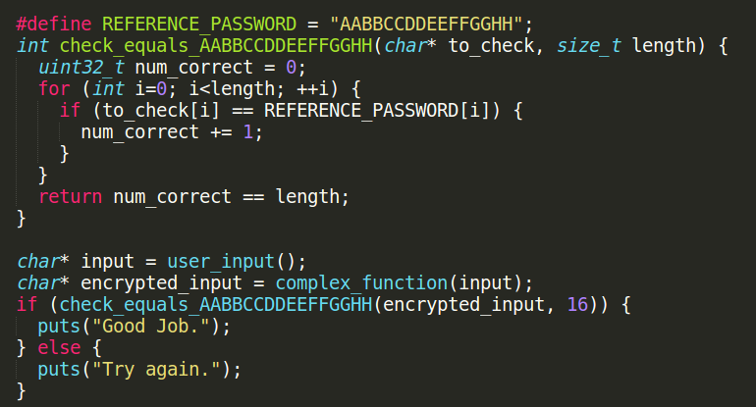
08_angr_constraints
After input is sent to complex_function, it is checked against a static string, one character at a time
complex_function makes reverse-engineering hard
Branching in check_equals_ makes symbolic execution hard

Slide 130
08_angr_constraints
check_equals… function equivalent to if *to_check == “AABBCCDDEEFFGGHH”, but causes 2^16 branches
Need input that generates “AABBCCDDEEFFGGHH” from complex_function
Use angr to stop before check, then constrain to_check variable to be equal to “AABBCCDDEEFFGGHH”

Slide 131
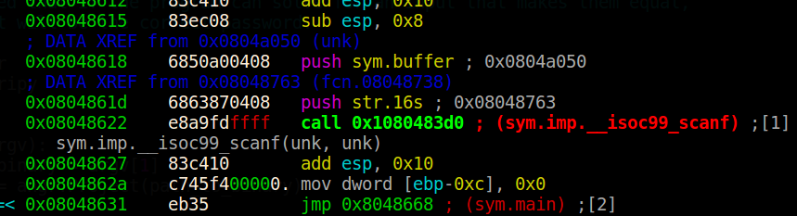
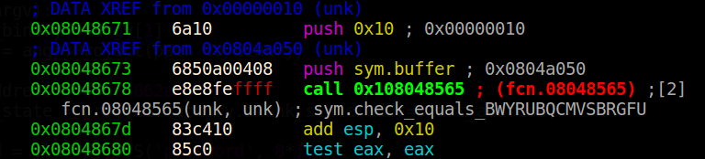
08_angr_constraints
Password buffer 16 bytes stored at 0x804a050
Can skip scanf by making buffer symbolic and starting just after scanf returns
Want to constrain symbolic buffer at 0x804a050 to be "BWYRUBQCMVSBRGFU" at 0x8048671

Slide 132
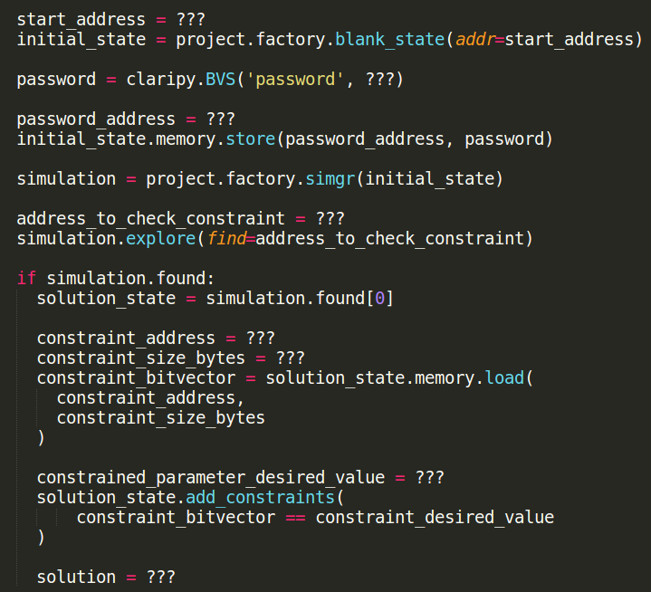
08_angr_constraints
Start at address when symbolic value is needed after scanf
Tell claripy how large the symbolic value is in bits
Get address of password and make it
symbolic
Stop exploration just before “check”
function that blows up symbolic
execution
Find address of value to constrain and
its size in bytes (e.g. password above)
Read symbolic value into bitvector
Set the contraint value and apply it to
solution_state
Concretize symbol to obtain solution

Slide 133
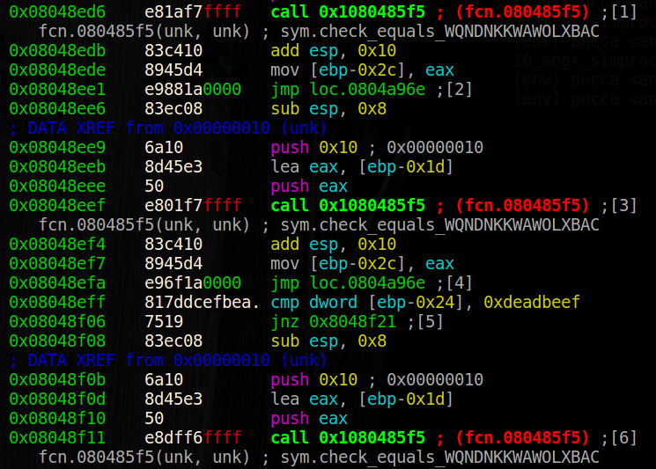
10_angr_simprocedures
Trolling constraints
check_equals… function now called 256 times
Manually adding constraints will be painful
Instead, hook function using a SimProcedure
% objdump -d 10_angr_simprocedures | egrep check_ | egrep call | head -5
8048771: call 80485f5 <check_equals_WQNDNKKWAWOLXBAC>
804878a: call 80485f5 <check_equals_WQNDNKKWAWOLXBAC>
80487ac: call 80485f5 <check_equals_WQNDNKKWAWOLXBAC>
80487c5: call 80485f5 <check_equals_WQNDNKKWAWOLXBAC>
80487f0: call 80485f5 <check_equals_WQNDNKKWAWOLXBAC>
% objdump -d 10_angr_simprocedures | egrep check_equals_WQNDNKKWAW | egrep call | wc -l
256

Slide 134
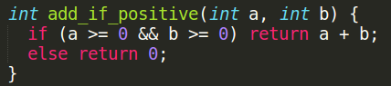
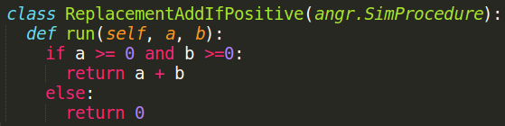
10_angr_simprocedures
How? Via subclass of angr.SimProcedure
But, needs to handle symbolic values, not concrete ones

Slide 135
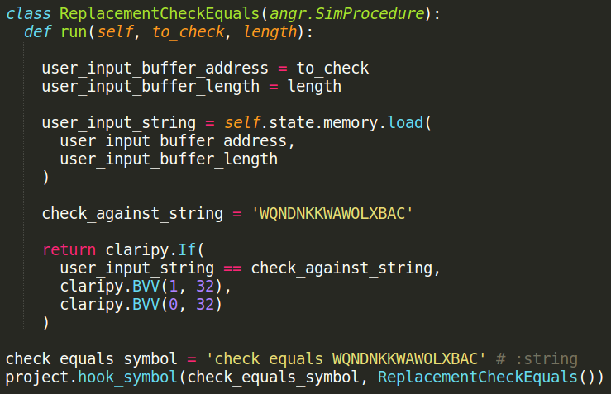
10_angr_simprocedures
Create SimProcedure
Define run method that has the same
function prototype as check_equals… (aside from initial self)
Grab function parameters for use
Load symbolic value that is at the location to_check
String checked by check_equals…
Perform the comparison in Python and return 0 or 1 back to symbolic execution engine (assumes 32-bit binary)
Identify function to hook, then hook it with created SimProcedure

Slide 136
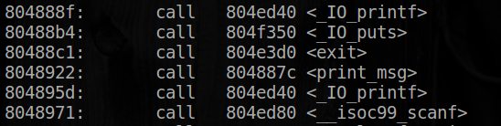
13_angr_static_binary
angr automatically hooks some dynamic library calls in libc with pre-written SimProcedures to avoid symbolically executing them (i.e. scanf@plt, puts@plt)
But, if libc is statically linked, the same calls must be manually hooked
List of implemented SimProcedures in libc
Level copied from 00_angr_find. Adapt the solution to hook statically linked libc calls used..
https://github.com/angr/angr/tree/master/angr/procedures/libc

Slide 137
Lab
Feel free to work with others, but you must run on your own to solve your own levels
08_angr_constraints
10_angr_simprocedures
11_angr_sim_scanf
13_angr_static_binary

Slide 138
Symbolic Execution CTF: Part 4
(An Intro to) Automatic Exploit Generation

Slide 139
Really Really High-level Strategy
1. Determine the type of exploit you want to search for, for example:
Arbitrary read (crash the program, read a password, etc)
Arbitrary write (inject shellcode, overwrite return address, etc)
Arbitrary jump (jump to your shellcode, return oriented programming, etc)
2. Write a Python function using Angr to determine if we have reached the condition necessary for the exploit.
3. Constrain the system in a way that would cause the attack to happen.
4. Allow Angr to solve for the input that meets the constraints.

Slide 140
Simple Example: Arbitrary Read
The admin password
An innocuous string
…
If we can find a buffer overflow that overwrites this pointer, we can print out the admin password
‘puts’ prints the string this pointer points at
Buffer; stores input from stdin

Slide 141
Simple Example: Arbitrary Read
The admin password
An innocuous string
…
Inject as much symbolic data as possible into the buffer!
(In this case, the buffer is larger than the amount of input the program accepts; it is not vulnerable to attack.)
‘puts’ prints the string this pointer points at
Buffer; stores input from stdin

Slide 142
Simple Example: Arbitrary Read
The admin password
An innocuous string
…
However, eventually we may come across an example that allows us to overwrite the pointer.
‘puts’ prints the string this pointer points at
Buffer; stores input from stdin

Slide 143
Simple Example: Arbitrary Read
The admin password
The question is: do we control it in such a way that we can point it at the admin password?
We determine this by constraining the pointer to point to the admin password and letting z3 do the heavy lifting.
An innocuous string
…
‘puts’ prints the string this pointer points at
Buffer; stores input from stdin

Slide 144
Simple Arbitrary Read Strategy
Initialize state
While we have not found a solution or exhaustively searched the binary:
For each active state:
If the program is calling puts (or printf, or network socket send, etc):
If the parameter (a pointer to a string to print) is symbolic and can be constrained to point to the memory address we want to read:
Constrain it as such
Solve for the user input
Step the active states

Slide 145
Simple Example: Arbitrary Write
The admin password
…
An innocuous buffer
If we can find a buffer overflow that overwrites this pointer, we can overwrite the admin password to be our own password!
‘strncpy’ copies the data from the user to the buffer the pointer points to
Buffer; stores input from stdin

Slide 146
Simple Example: Arbitrary Write
The admin password (though now it’s ours!)
To determine if we can find a way to write to the buffer, attempt to constrain the buffer to equal our desired password.
…
An innocuous buffer
Strategy is largely the same as previously shown regarding the pointer.
‘strncpy’ copies the data from the user to the buffer the pointer points to
Buffer; stores input from stdin

Slide 147
Simple Arbitrary Write Strategy
Initialize state
While we have not found a solution or exhaustively searched the binary:
For each active state:
If the program is calling strncpy (or memcpy, etc):
If the destination pointer and the source buffer are symbolic:
Constrain them to equal what we want
Solve for the user input
Step the active states

Slide 148
Simple Example: Arbitrary Jump
To determine if we can find a buffer overflow that would lead to an arbitrary jump, we could search for a situation where the return address of a function is unconstrained:
ebp
Return address
Buffer that stores user input that overflows into the return address
esp
But, many stack locations to track and locations unknown
There’s an easier way…

Slide 149
Simple Example: Arbitrary Jump
Search for a situation where the instruction pointer (ip) is unconstrained:
eip

Slide 150
One State, Many Possibilities
Typically, when the instruction pointer becomes symbolic, Angr branches:
# A simple guessing game.
user_input = raw_input('Enter the password: ')
if user_input == 'hunter2':
print 'Good Job.'
else:
print 'Try again.'
You could consider reaching both of these print statements as a single state, where the instruction pointer can take on multiple values: the address of “print ‘Good Job.’” or the address of “print ‘Try again.’”

Slide 151
Oh the Places You’ll Go!
When the instruction pointer is unconstrained, there are an infinite* number of possible branches. Execution cannot continue.
eip
Normally, Angr throws away unconstrained states and continues with other paths that have a logical continuation.
In our case, we want to save them and determine if we can constrain the instruction pointer to equal the address of our malicious code.

Slide 152
Simple Arbitrary Jump Strategy
Initialize state; instruct Angr to save unconstrained states
While we have not found a solution or exhaustively searched the binary:
For each unconstrained state (commonly will be none):
If we can constrain the instruction pointer to what we want:
Constrain the instruction pointer
Solve for input
Step every active state

Slide 153
Angr-y CTF levels of Previous Examples

Slide 154
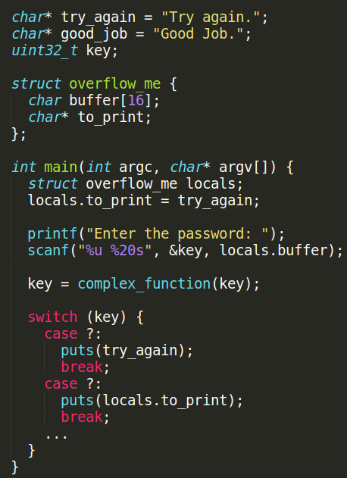
15_angr_arbitrary_read
Overflow buffer to overwrite the locals.to_print pointer to point to good_job.
Then, have puts read from it to print “Good Job.”
Strategy
Replace scanf with a SimProcedure
Check each puts to see if it is ever given a pointer that is symbolic
If symbolic, constrain pointer to see if it can be set to good_job
Will also want to ensure solution constrained to be alphanumeric for ease of input

Slide 155
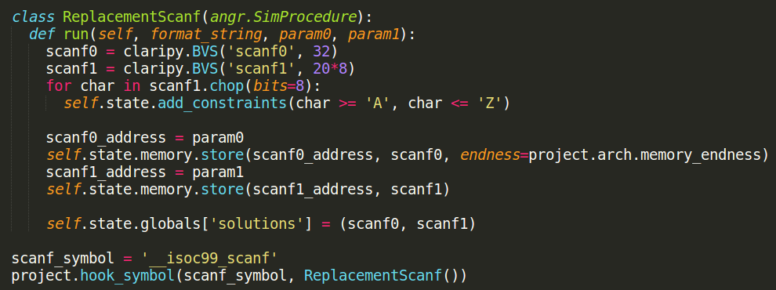
15_angr_arbitrary_read
scanf("%u %20s") can be replaced with SimProcedure
Declare symbolic values for two inputs
Add constraint on string to consist of capital letters only *** BUG ALERT *** (use '}' at top)
Store symbolic variable into memory where it belongs
Add to globals so they can be accessed later
Hook call

Slide 156
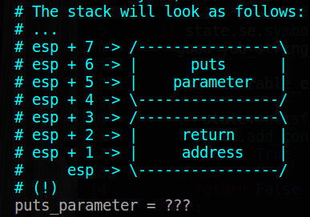
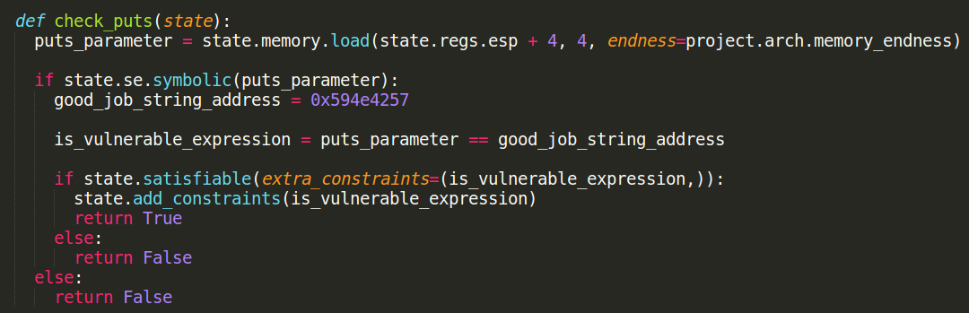
15_angr_arbitrary_read
Check if puts can print “Good Job.”
Load the parameter to puts based on stack layout
Test if it is symbolic
If so, create a constraint to see if it can be set to the address of “Good Job.”
If so, add the constraint to the state and return true (solution found)

Slide 157
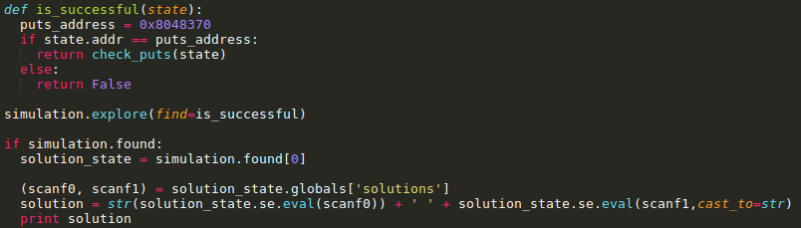
15_angr_arbitrary_read
Define a successful state
Check to see if you are at puts@plt
Call the previous check_puts function that determines if parameter is symbolic and can be set to the location of “Good Job.”
If state is found, solve for scanf0 and scanf1 and output solution

Slide 158
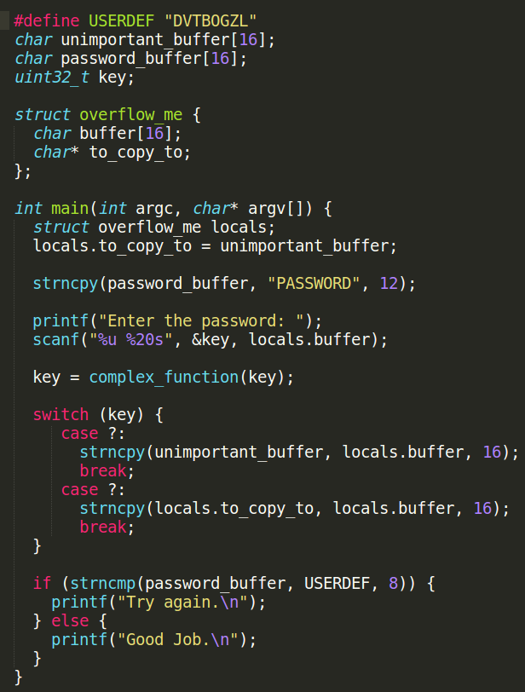
16_angr_arbitrary_write
Vulnerable buffer allows the overwrite of a pointer used in subsequent strncpy
password_buffer set to “PASSWORD” then compared to “DVTBOGZL”
Always fails unless one can hijack a strncpy call to overwrite password_buffer with “DVTBOGZL”
Strategy
Replace scanf with a SimProcedure (as before)
Check each strncpy to see if it has a source buffer that is symbolic and a destination pointer that is symbolic
Constrain pointer to point to password_buffer

Slide 159
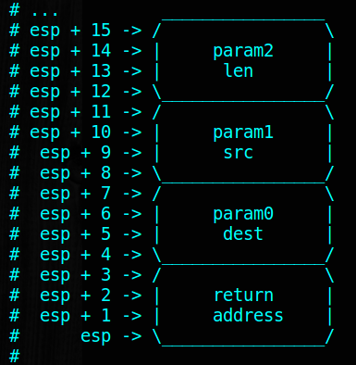
16_angr_arbitrary_write
Check upon entry to strncpy
strncpy_dst at esp+4
stncpy_src at esp+8
strncpy_len at esp+12

Slide 160
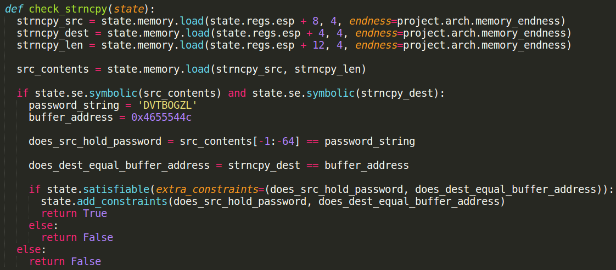
16_angr_arbitrary_write
check_strncpy
Pull parameter values from execution state
Since we want source buffer itself to be symbolic, use source pointer to load it
Check if both the source buffer and destination pointer are symbolic
If so, attempt to constrain source buffer to contain ‘DVTBOGZL’ and destination pointer point to password_buffer

Slide 161
16_angr_arbitrary_write
check_strncpy
If constraints are satisfiable, then add them to the state and return True
Otherwise, return False to continue execution.

Slide 162
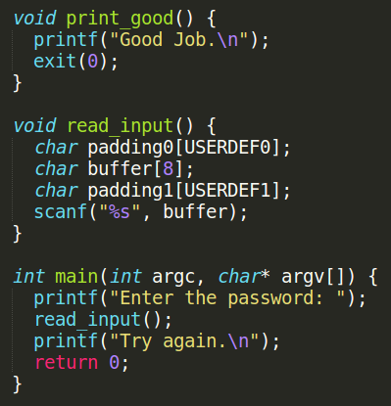
17_angr_arbitrary_jump
Program appears to always print “Try again”
But, vulnerable buffer allows us to overwrite return address in read_input
Overflow buffer return to print_good instead of main()
So far we have seen symbolic…
Memory, files, pointers, and registers
All data
Looking for when %eip becomes symbolic
And specifically, unconstrained
Angr will throw away state by default
But, unconstrained %eip is what we need
Strategy
Create a check for symbolic %eip
Attempt to constrain it to print_good

Slide 163
17_angr_arbitrary_jump
Issues
Can not do an explore since its “find” parameter can not be called from an unconstrained state
Must explore the binary manually
Construct exit condition
Keep lists of states based on whether they are active, dead-ended, unconstrained, errored, or found
Iterate forever
Check if solution found
Move all unconstrained states to found if they can be constrained to have %eip set to print_good
Step simulation

Slide 164
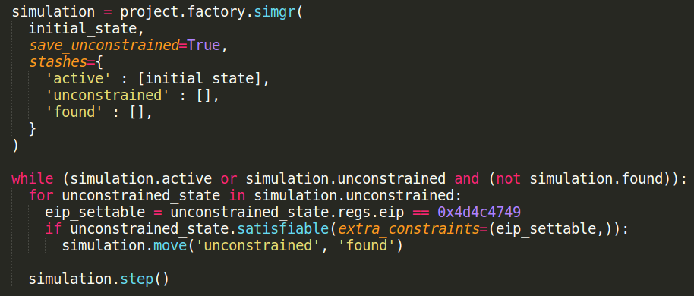
17_angr_arbitrary_jump
Instantiate simulation with places to hold active, unconstrained, and found states
While not found and while there are still states to look at
Step simulation and check for unconstrained states that can meet the requirement of %eip being settable to address of print_good

Slide 165
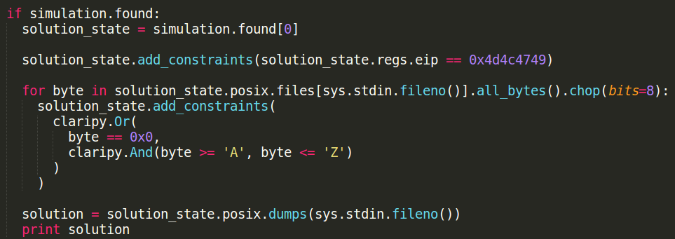
17_angr_arbitrary_jump
When found, add constraints to solution
%eip set to print_good
Make input to overflow buffer consist of all capital letters
Note: level is designed with addresses that are also capital letters

Slide 166
Not-so Automatic Exploit Generation
A few questions may come to mind:
How do we know what we want to read/write/jump to?
How do we determine if the computer is making an arbitrary read/write for the general case (strncpy isn’t used)?
Human intuition!
Researchers have only come up with mediocre algorithms for the general case (so far.)
If you find a better solution, publish it.

Slide 167
Complex Exploits
Real-world programs may not be exploitable by these simple approaches.
You may need to perform some combination of them, or take a different approach entirely.
To automatically do so is a very hard problem.

Slide 168
Conclusion
In some cases, symbolic execution can be a very powerful tool to automate vulnerability & bug discovery.
It is not a miracle algorithm that can autonomously discover any bug.
Nonetheless, understanding symbolic execution helps us understand the underlying concepts involved in exploit discovery, and gives us a powerful tool to use and research.

Slide 169
Lab
Feel free to work with others, but you must run on your own to solve your own levels
15_angr_arbitrary_read
16_angr_arbitrary_write
17_angr_arbitrary_jump

